Slide 1
Computer Vision Final Report
Team members: Chenhao Li, Rufan Zhang, Shaoxuan zhou, Haoyun Yang
Speaker: Chenghao Li, Shaoxuan Zhou
2025.05.26

Slide 2
First Assignment - Building a neural network model for classification problem

Slide 3
The strategy to explore the combinations of techniques
Initially, establish a baseline model configuration utilizing our existing knowledge of deep learning.
Following this, investigate each optimization technique separately, while preserving the most effective settings from previous explorations.For example,
Explore learning rate scheduling methods and identify the most suitable one; Incorporate this method into your model.
Explore activation functions and select the most appropriate one; Use this activation function in our model.
Explore various optimizers and choose the optimal one for your model
Continue this process to explore additional techniques.

Slide 4
MLP

Slide 5
Baseline & Techniques we explore & Best
 | Baseline | Techniques we explore | Best
Hidden layers | 3 | 3,4,5 | 3
Neurons | 128 | 32,64,128 | 128
Learning rate scheduler | None(lr=0.1) | None(lr=0.1), StepLR, ReduceLROnPlateau | StepLR
Activation function | ReLU | RELU, ELU, LeakyReLU | ELU
Optimizer | Adam | Adam, SGD, RMSprop | SGD
Batch normalization | True | True, False | True
Regularization | L1 | None, L1, L2 | L1
Dropout | True | True, False | True
Notes:
baseline的设置参考了A contextual analysis of multi-layer perceptron models in classifying hand-written digits and letters:limited resources 这篇文章。

Slide 6
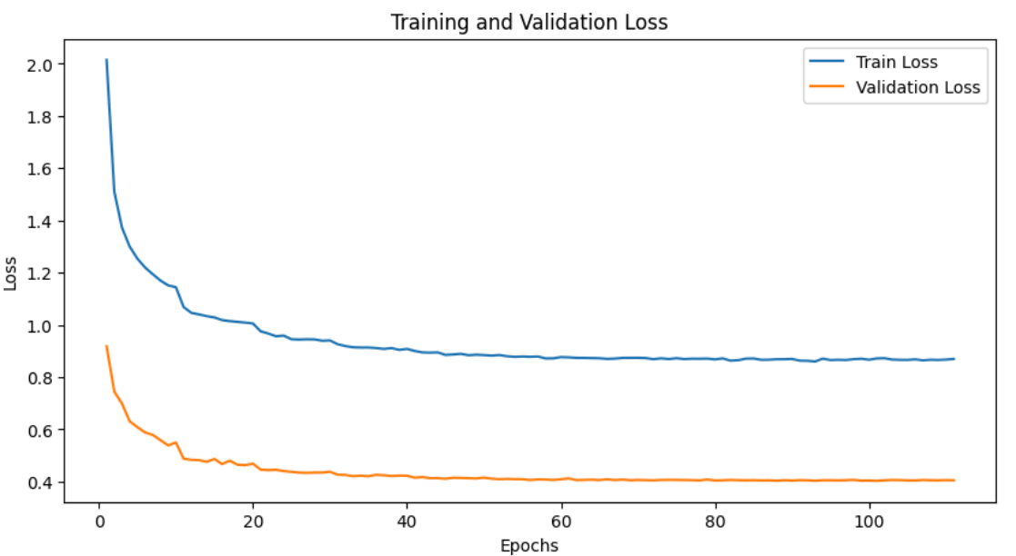
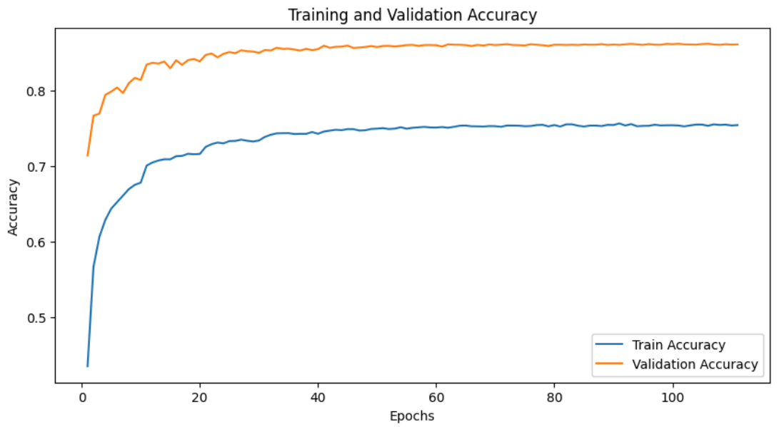
The results of the best model
Train and validation loss
Train and validation accuracy
The accuracy of the best model on test set is 0.8614
Notes:
训练过程中采用早停的策略，如果连续10个epoch，模型在val datasets上的accuracy都没有提升，就停止训练

Slide 7
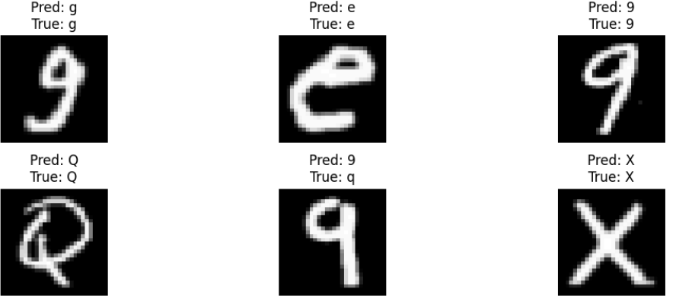
The results of the best model
The predicted results of the best model on test set
Notes:
查看具体的结果我们发现，MLP可以识别出大部分的字母和数字，但对于比较相似的字母和数字识别起来有一定的困难，比如q和9.接下来，通过观察混淆矩阵进一步证明这一点。

Slide 8
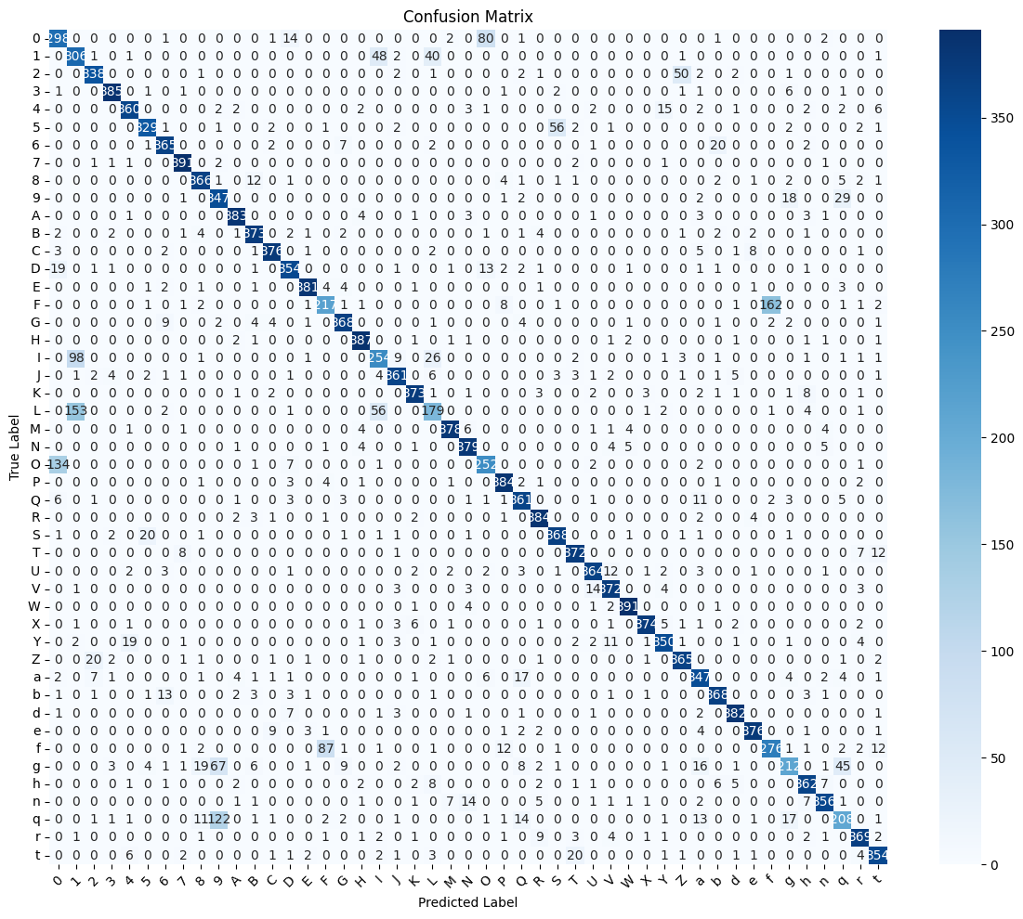
The results of the best model
Notes:
通过观察混淆矩阵我们发现，的确被预测错误的例子绝大部分是由字母和数字间比较相近造成的。比如0和O，L和1，F和f

Slide 9
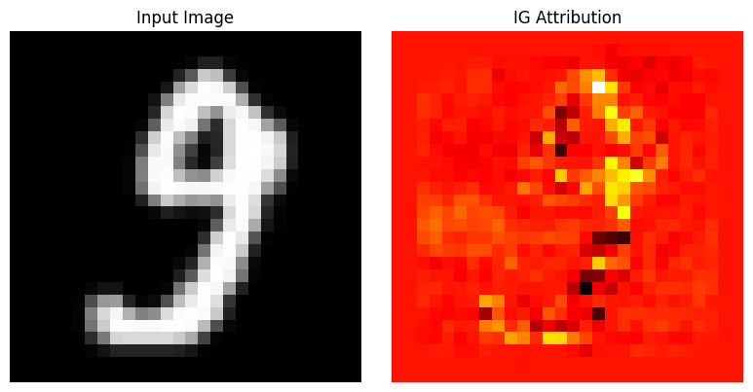
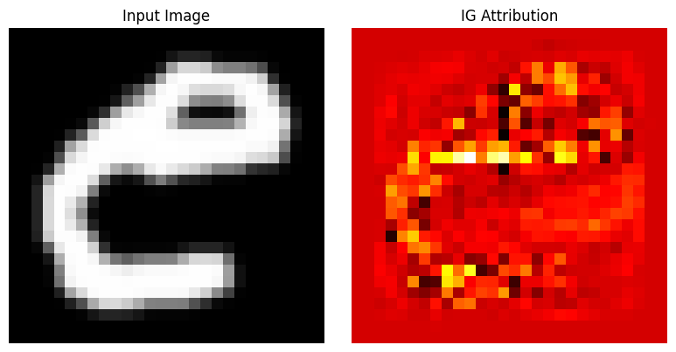
The results of the best model
The importance of each pixel
Notes:
最后，我们来看一下，每个输入的像素对模型预测结果的影响大小。我们使用 Integrated Gradients（积分梯度）方法可视化一个模型对输入图像做出某个预测时，输入的每个像素的重要性贡献。

Slide 10
CNN

Slide 11
Baseline & Techniques we explore & Best
 | Baseline | Techniques we explore | Best
Convolutional layers | 2 | 2,3 | 3
Filters | [32,64] | [32,64], [32,64,128] | [32,64,128]
Kernel size | [3,3] | [3,3], [5, 3], [3, 3, 3], [5, 5, 3] , [5, 3, 3] | [5,5,3]
Learning rate scheduler | CosineAnnealingLR | StepLR, CosineAnnealingLR, ReduceLROnPlateau | CosineAnnealingLR
Activation function | ReLU | ReLU, ELU, LeakyReLU | LeakyReLU
Optimizer | Adam | Adam, SGD, RMSprop | Adam
Batch normalization | True | True, False | True
Regularization | None | None, L1, L2 | None
Dropout | True | True, False | False

Slide 12
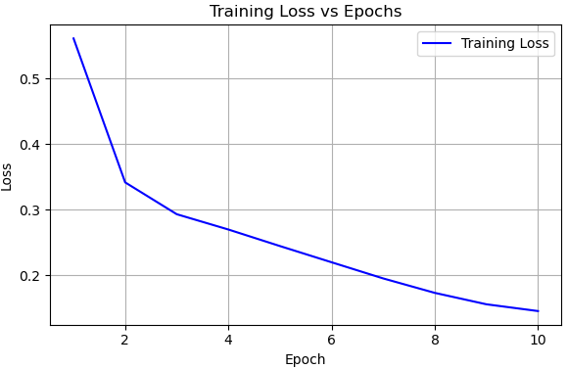
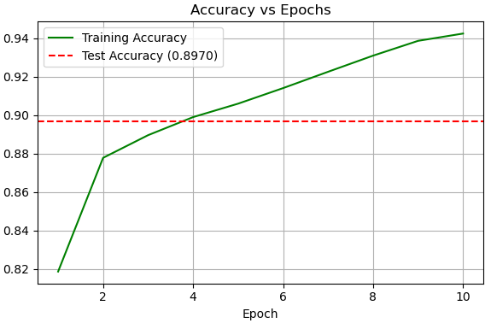
The results of the best model
Train and validation loss
Train accuracy

Slide 13
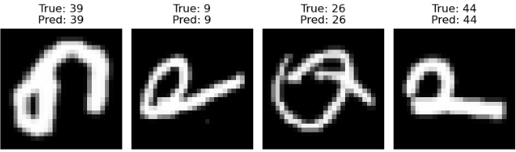
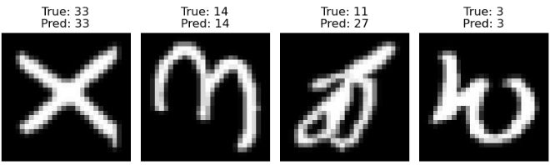
The results of the best model
The predicted results of the best model on test set

Slide 14
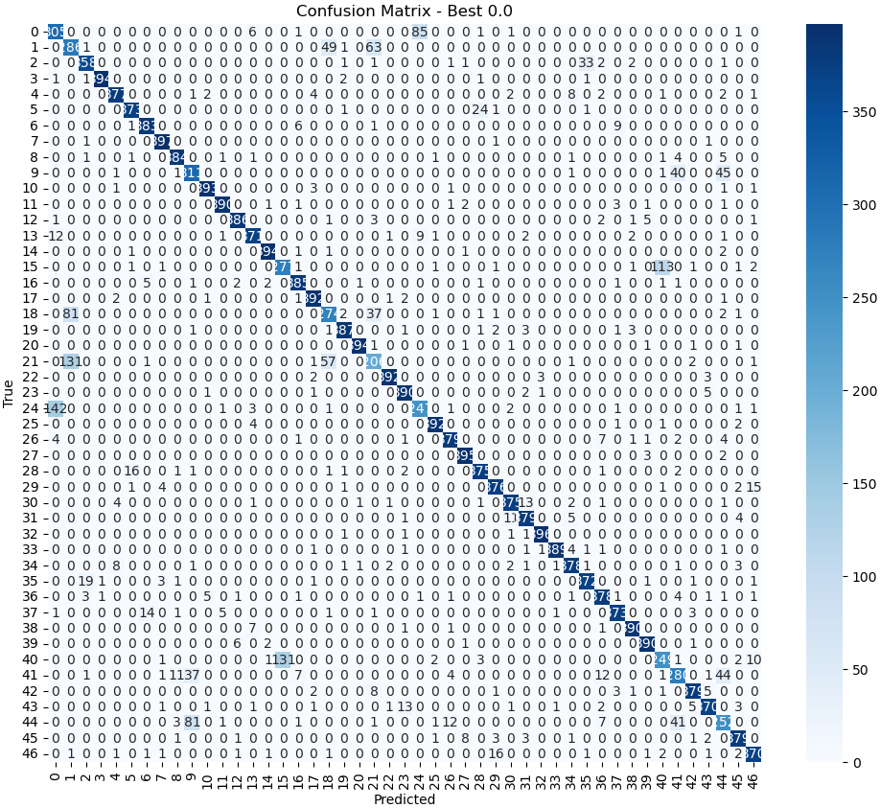
The results of the best model

Slide 15
Resnet

Slide 16
Baseline & Techniques we explore & Best
 | Baseline | TO explore | Best
Residual blocks | [2, 2, 2] | [2, 2, 2], [3, 3, 3], [1, 2, 3] | [2, 2, 2]
Filters | [64, 128, 256] | [64, 128, 256] | [64, 128, 256]
Learning rate scheduler | CosineAnnealingLR | CosineAnnealingLR, StepLR, ReduceLROnPlateau | CosineAnnealingLR
Activation function | LeakyReLU | ReLU, ELU, LeakyReLU | LeakyReLU
Optimizer | Adam | Adam, SGD, RMSprop | Adam
Batch normalization | True | True, False | True
Regularization | None | None, L1, L2 | None
Dropout | False | True, False | False

Slide 17
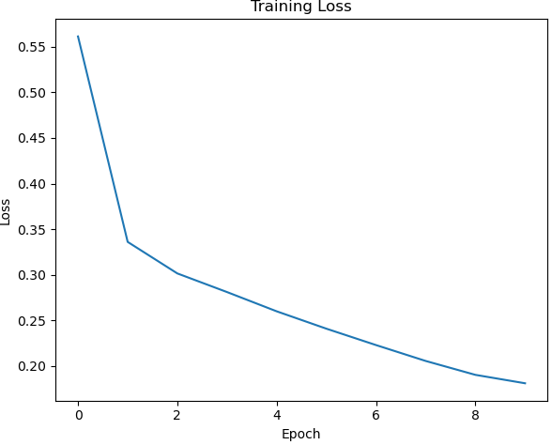
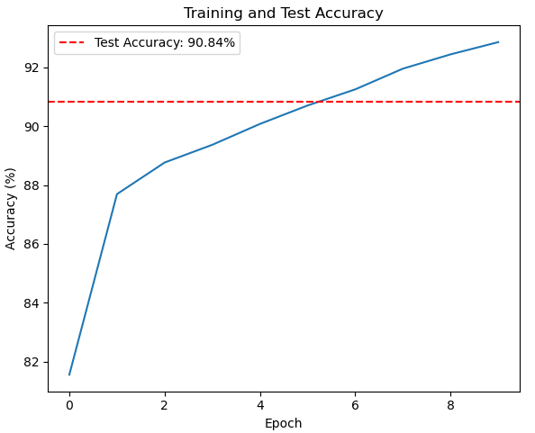
The results of the best model
Train and validation loss
Train accuracy

Slide 18
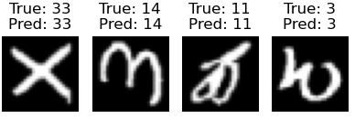
The results of the best model
The predicted results of the best model on test set

Slide 19
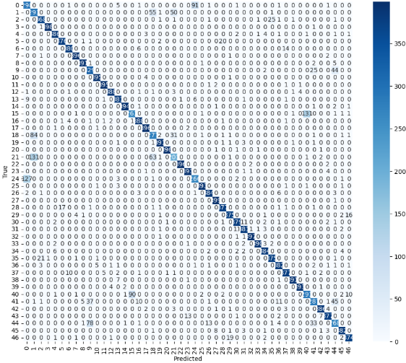
The results of the best model

Slide 20
Second Assignment
A Review of the Robustness of Deep Learning Models to Common Image Distortions and Corruptions

Slide 21
Table of contents
Research background and core issues
Common Image corruptions classification and benchmark datasets
Evaluation Metrics
Enhancing Robustness to Common Corruptions
Challenges, future directions and summary

Slide 22
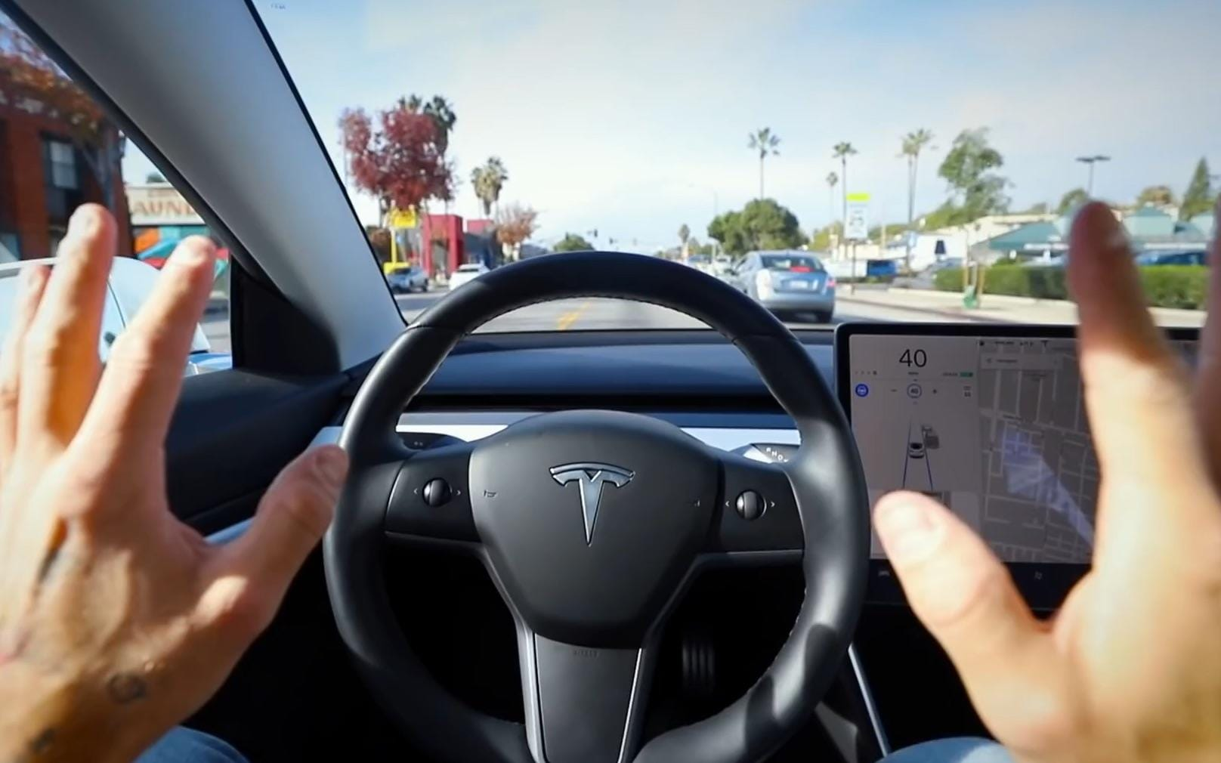
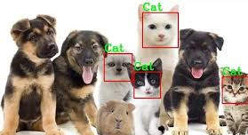
Research background and core issues
Deep learning has had many successes

Slide 23
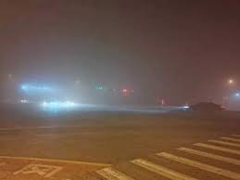
Research background and core issues
What would happen if self-driving cars couldn’t recognize traffic lights in heavy fog?

Slide 24
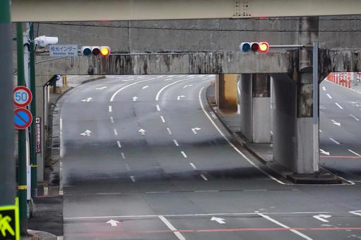
Research background and core issues
Image Corruption：These corruptions are not malicious, intentionally crafted attacks, but rather naturally occurring degradations that arise from various factors inherent in the image lifecycle: imperfections in camera sensors, suboptimal lighting conditions, motion blur, atmospheric phenomena, or artifacts introduced during image compression and transmission。

Slide 25
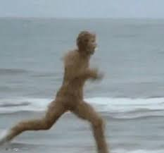
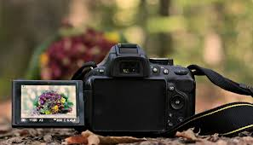
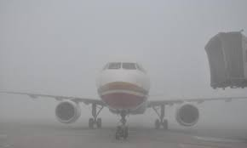
Research background and core issues
Purpose：The scope of this literature review is to systematically survey and analyze the research pertaining to the robustness of deep learning models against common, naturally occurring image distortions and corruptions。

Slide 26
Common Image corruptions classification and benchmark datasets
Common image corruption classifications：
Noise Corruptions: These involve adding random pixel-level variations.
Blur Corruptions: These simulate various forms of image un-focusing or smearing.
Weather Corruptions: These mimic degradations caused by atmospheric conditions.
Digital Corruptions: These represent artifacts introduced during digital image processing or transmission.

Slide 27
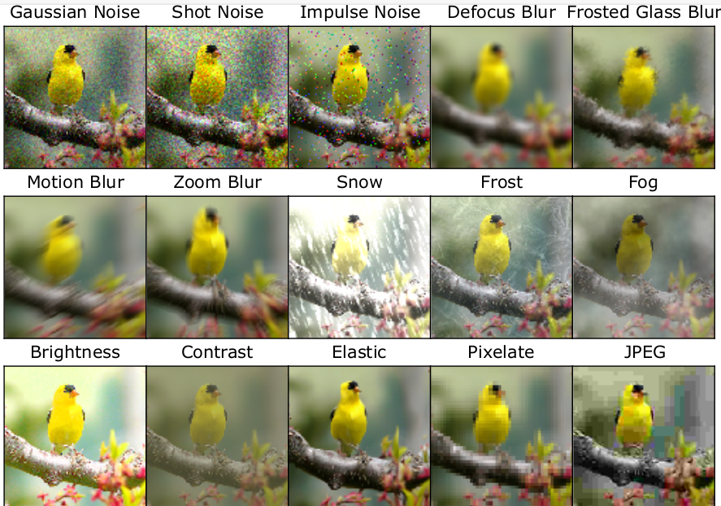
Common Image corruptions classification and benchmark datasets
Foundational Benchmarks：
ImageNet-C and ImageNet-P
CIFAR-10-C and CIFAR-100-C
IMAGENET-C dataset consists of 15 types of algorithmically generated corruptions

Slide 28
Common Image corruptions classification and benchmark datasets
Domain-Specific Benchmarks：
The need for robustness in specific application domains has led to the creation of tailored benchmarks:
Digital Pathology
Person Search
Autonomous Driving

Slide 29
Common Image corruptions classification and benchmark datasets
Newer and More Diverse Benchmarks：
The field continues to evolve, with newer benchmarks aiming to address limitations of earlier ones or to test different facets of robustness:
PASCAL VOC-C, COCO-C, and Cityscapes-C;
ImageNet-C̄ and CIFAR-C̄
ImageNet-R
ImageNet-D
ImageNet-3DCC

Slide 30
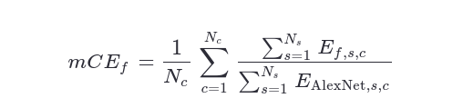
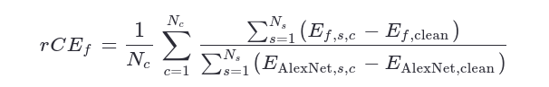
Evaluation Metrics
Error-Based Metrics：
Corruption Error (CE)
Mean Corruption Error (mCE)
Relative Mean Corruption Error (rCE)

Slide 31
Evaluation Metrics
Perception and Dataset-Aware Metrics：
Visually-Continuous Corruption Robustness (VCR) Metrics:
Robustness under continuous degradation
Mean Statistical Corruption Robustness (MSCR)
Robustness measure based on intrinsic separability distance of dataset

Slide 32
Evaluation Metrics
Confidence and Consistency Metrics：
Expected Calibration Error (ECE):
The difference between prediction confidence and actual accuracy
Corruption Error of Confidence (CEC):
Confidence in matches decreasing with damage severity
Mean Flip Rate (mFR):
Frequency of change of predicted labels in perturbation sequence

Slide 33
Enhancing Robustness to Common Corruptions
Category Prominent Techniques | Category Prominent Techniques
Data Augmentation | Basic Transforms Mixup CutMix AutoAugment AugMix Stylized-ImageNet DAMP Generative Models (GANs, Diffusion) Test-Time Augmentation/Adaptation
Architectural Design | BlurPool Adaptive Normalization (AdaBN, PAN) Robust Vision Transformer (RVT)
Training Strategies | Adversarial Logit Pairing (ALP) Sharpness-Aware Minimization (SAM) Contrastive Learning (SimCLR, GPaCo) Knowledge Distillation (NoisyStudent, DAD)

Slide 34
Challenges, future directions and summary
Challenges：
Inadequate generalization:
Poor robustness to unseen damage types such as dynamic weather changes.
Efficiency bottleneck:
Most enhancement methods increase training costs
Lack of theory:
Lack of mathematical explanation of the nature of robustness

Slide 35
Challenges, future directions and summary
Future directions：
Future research should focus on developing intrinsically robust architectures and training paradigms to promote the model's generalization ability in unseen complex real-world damage through advanced data synthesis, more realistic adaptive benchmarks, and in-depth exploration of the theoretical basis of robustness.

Slide 36
Challenges, future directions and summary
Conclusion：
In the future, multidisciplinary collaboration is needed to promote the expansion of robustness from classification tasks to complex scenarios such as detection and segmentation, and ultimately realize the trustworthy application of AI in unpredictable environments.

Slide 37
Thank you for your listening!

